Slide 1
Density-based Clustering

Slide 2
Density-based spatial clustering of applications with noise (DBSCAN)

Slide 3
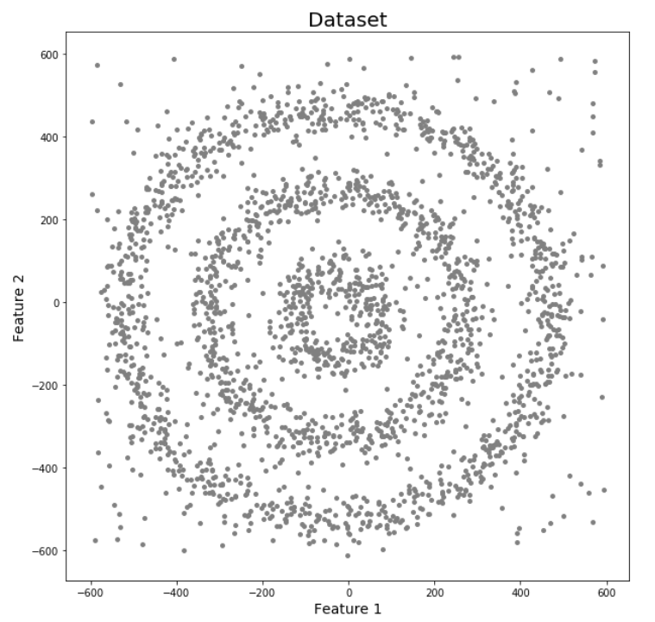
Limitation of K mean or Hierarchical Clustering
K-Means and Hierarchical Clustering both fail in creating clusters of arbitrary shapes. They are not able to form clusters based on varying densities. That’s why we need DBSCAN clustering.
Let’s try to understand it with an example. Here we have data points densely present in the form of concentric circles:

Slide 4
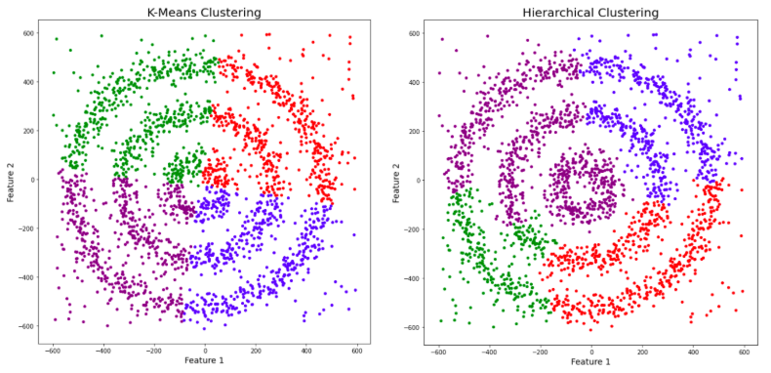
We can see three different dense clusters in the form of concentric circles with some noise here in the above diagram . Now, let’s run K-Means and Hierarchical clustering algorithms and see how they cluster these data points.

Slide 5
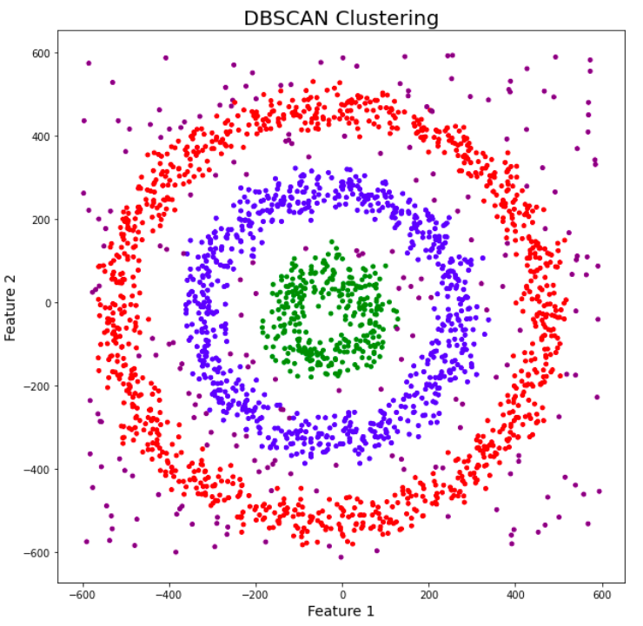
You might be wondering why there are four colors in the graph? As I said earlier, this data contains noise too, therefore, I have taken noise as a different cluster which is represented by the purple color. Sadly, both of them failed to cluster the data points. Also, they were not able to properly detect the noise present in the dataset. Now, let’s take a look at the results from DBSCAN clustering.
DBSCAN is not just able to cluster the data points correctly, but it also perfectly detects noise in the dataset.

Slide 6
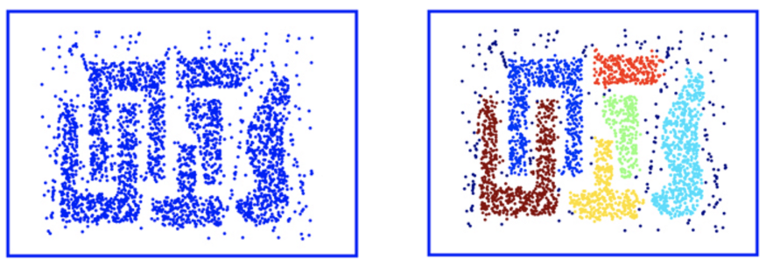
Strengths DBSCAN is resistant to noise and can handle clusters of various shapes and sizes. They are a lot of clusters that DBSCAN can find that K-mean would not be able to find. For instance Figure 4 (left) shows the original data points and Figure 5 shows on the right, the clusters created using the DBSCAN algorithm. As you examine these images it is important to not that the noise around the outer parameters are handled appropriately.

Slide 7
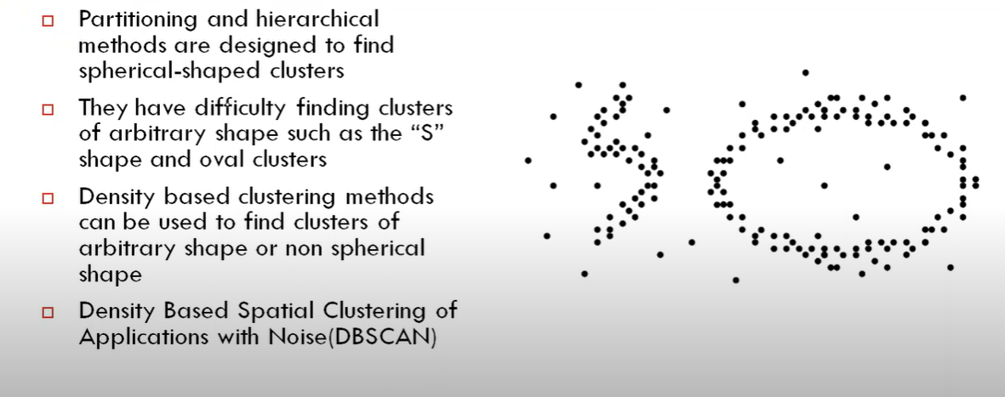
Density Based Clustering Method

Slide 8
Given that DBSCAN is a density-based clustering algorithm, it does a great job of seeking areas in the data that have a high density of observations, versus areas of the data that are not very dense with observations.
A cluster is defined as a maximal set of density-connected points.

Slide 9
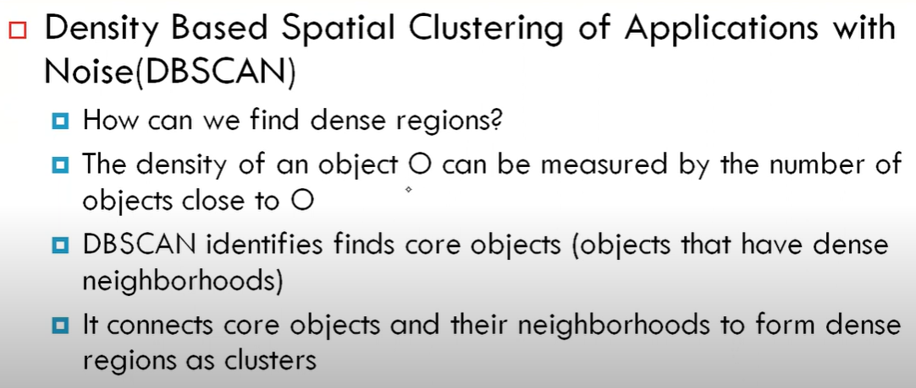

Slide 10
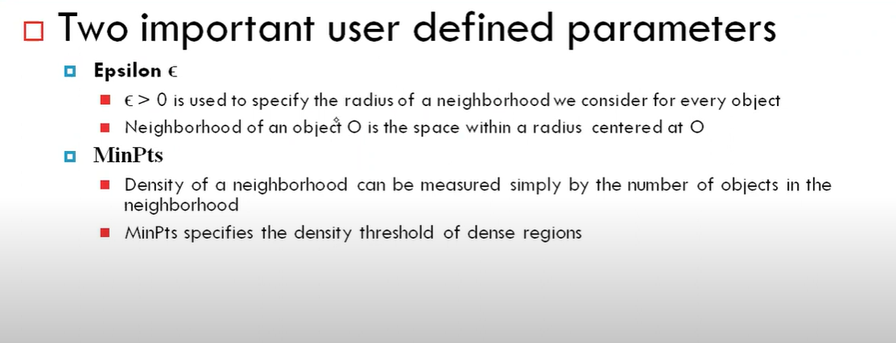

Slide 11
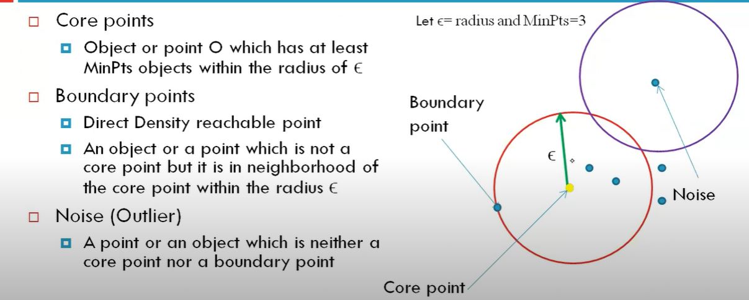
Types of Points

Slide 12
DBSCAN: Density Based Spatial Clustering of Applications with Noise
Relies on a density-based notion of cluster: A cluster is defined as a maximal set of density-connected points
Discovers clusters of arbitrary shape in spatial databases with noise

Slide 13
Density-Based Clustering Methods
Clustering based on density (local cluster criterion), such as density-connected points
Major features:
Discover clusters of arbitrary shape
Handle noise
One scan
Need density parameters as termination condition
Several interesting studies:
DBSCAN: Ester, et al. (KDD’96)
OPTICS: Ankerst, et al (SIGMOD’99).
DENCLUE: Hinneburg & D. Keim (KDD’98)
CLIQUE: Agrawal, et al. (SIGMOD’98) (more grid-based)

Slide 14
Density-based Clustering
Definition. Density-Based Clustering refers to unsupervised learning methods that identify distinctive groups/clusters in the data, based on the idea that a cluster in a data space is a contiguous region of high point density, separated from other such clusters by contiguous regions of low point density.

Slide 15
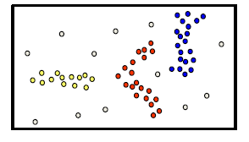
Density-based Clustering
Basic idea
Clusters are dense regions in the data space, separated by regions of lower object density
A cluster is defined as a maximal set of density connected points

Slide 16
Concepts
Reachability in terms of density establishes a point to be reachable from another if it lies within a particular distance (eps) from it.
Connectivity on the other hand, involves a transitivity based chaining-approach to determine whether points are located in a particular cluster.
For example, p and q points could be connected if p->r->s->t->q, where a->b means b is in the neighborhood of a.

Slide 17
Definitions of important terms
ε (epsilon): the radius of a neighborhood centered on a given point.
MinPts: Minimum number of points in an ε neighborhood of that point.
High density region: It is the region if the ε (epsilon) neighborhood of an object contains atleast MinPts of objects. If not then that region is called low density region.
Core Point: a given point is considered as a Core Point if there are at least minPts points within its ε neighborhood, including itself.
Border Point: a given point is considered a Border Point if there fewer than minPts points within its ε neighborhood, including itself, but it is in the neighborhood of a core point.
Noise: any point that is not a Core Point or Border Point
Directly Density Reachable: a given point is Directly Density Reachable (ε Reachable) from another point if the second point is a core point, and the first point lies within the ε neighborhood of the second point
Density Reachable: a given point is Density Reachable from another point if there is a chain of points, Directly Density Reachable from each other, that connects them

Slide 18
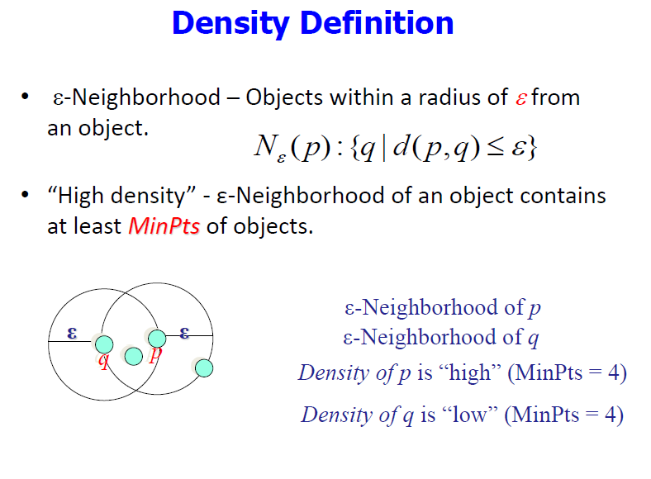

Slide 19
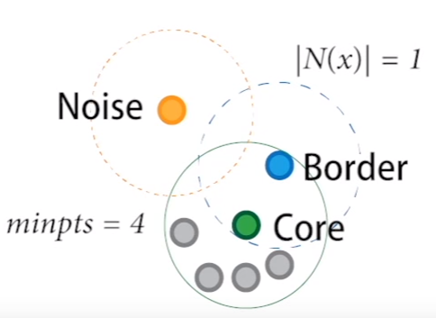

Slide 20
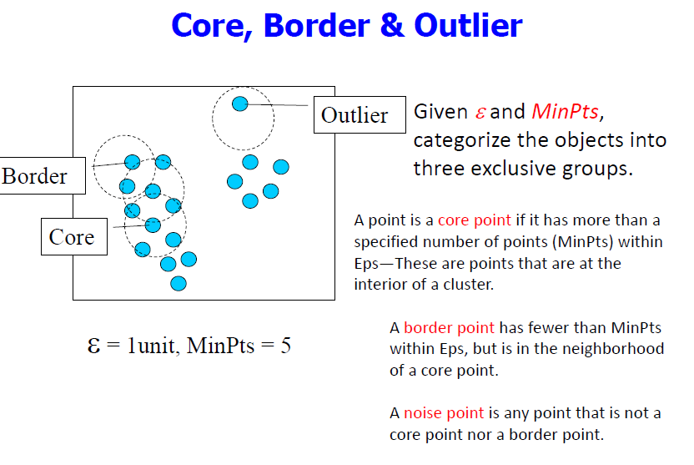

Slide 21
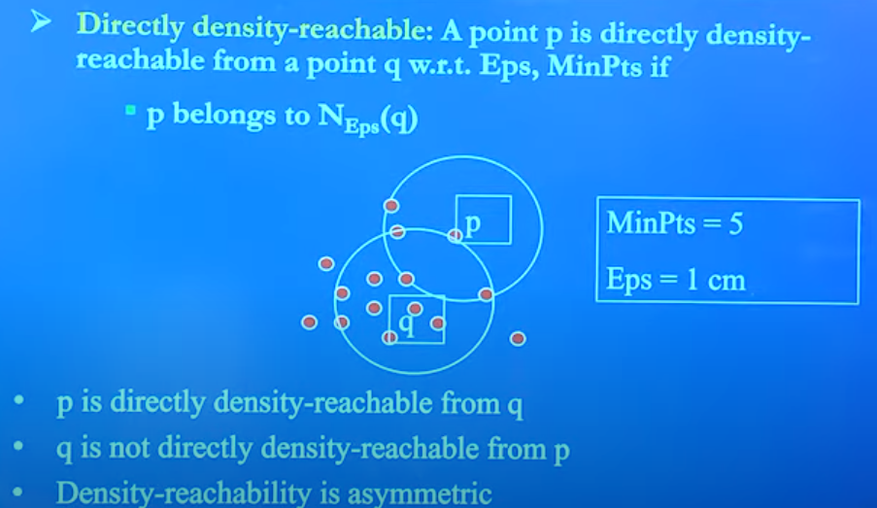
Directly Density reachable

Slide 22
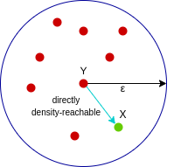
Directly density-reachable
A point X is directly density-reachable from point Y w.r.t epsilon, minPoints if,
X belongs to the neighborhood of Y, i.e, dist(X, Y) <= epsilon
Y is a core point
Directly density-reachable concept id asymmetric
Here, X is directly density-reachable from Y, but vice versa is not valid.

Slide 23
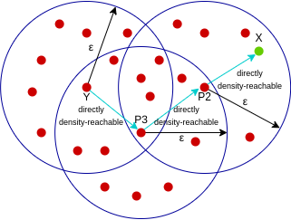
Density-reachable
A point X is density-reachable from point Y w.r.t epsilon, minPoints if there is a chain of points p1, p2, p3, …, pn and p1=X and pn=Y such that pi+1 is directly density-reachable from pi. Density-reachable concept is symmetric.
Notes:
X is density reachable from point Y , if there exit a intermediate point that is DDR to Y and intern X is DDR from P3

Slide 24
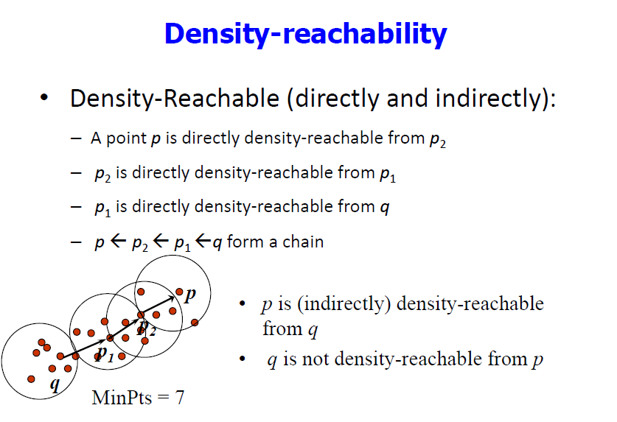

Slide 25
Density-Reachable and Density-Connected
Density-reachable:
A point p is density-reachable from a point q w.r.t. Eps, MinPts if there is a chain of points p₁, …, p_{n}, p₁ = q, p_{n} = p such that p_{i+1} is directly density-reachable from p_{i}
Density-connected
A point p is density-connected to a point q w.r.t. Eps, MinPts if there is a point o such that both, p and q are density-reachable from o w.r.t. Eps and MinPts.
p
p₁
q
p
q
o

Slide 26
Density-based Clustering
A density-based algorithm.
Density = number of points within a specified radius r (Eps)
A point is a core point if it has more than a specified number of points (MinPts) within Eps
These are points that are at the interior of a cluster
A border point has fewer than MinPts within Eps, but is in the neighborhood of a core point
A noise point is any point that is not a core point or a border point.

Slide 27
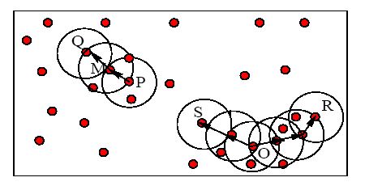
Example
M, P, O, and R are core objects since each is in an Eps neighborhood containing at least 3 points
Minpts = 3
Eps=radius of the circles

Slide 28
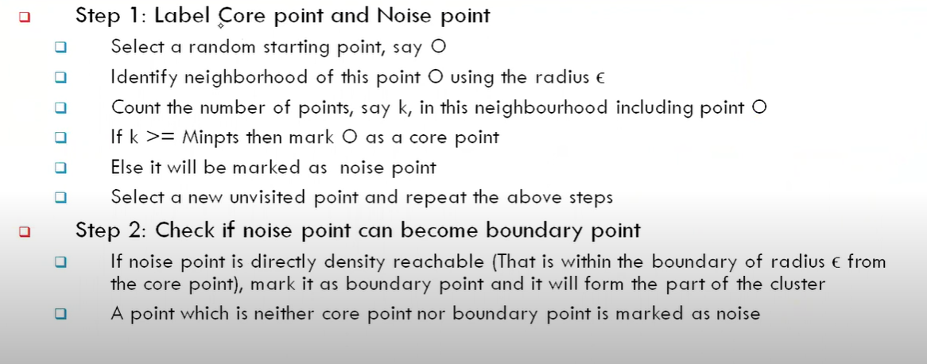
Algorithm steps

Slide 29
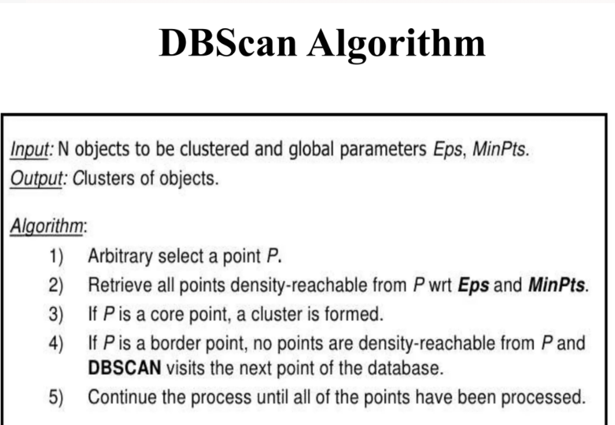

Slide 30
Advantages of DBSCAN:
Is great at separating clusters of high density versus clusters of low density within a given dataset.
Is great with handling outliers within the dataset.
Disadvantages of DBSCAN:
While DBSCAN is great at separating high density clusters from low density clusters, DBSCAN struggles with clusters of dissimilar density.
Struggles with high dimensionality data

Slide 31
DBSCAN vs K-Means Clustering
DBSCAN is a popular clustering algorithm that is fundamentally very different from k-means.
In k-means clustering, each cluster is represented by a centroid, and points are assigned to whichever centroid they are closest to. In DBSCAN, there are no centroids, and clusters are formed by linking nearby points to one another.
k-means requires specifying the number of clusters, ‘k’. DBSCAN does not but does require specifying two parameters which influence the decision of whether two nearby points should be linked into the same cluster. These two parameters are a distance threshold, ε (epsilon), and “MinPts” (minimum number of points), to be explained.
k-means runs over many iterations to converge on a good set of clusters, and cluster assignments can change on each iteration. DBSCAN makes only a single pass through the data, and once a point has been assigned to a particular cluster, it never changes.

Slide 32
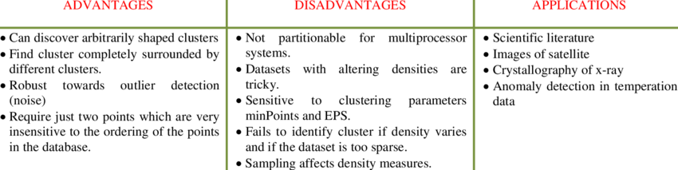
DBSCAN

Slide 33
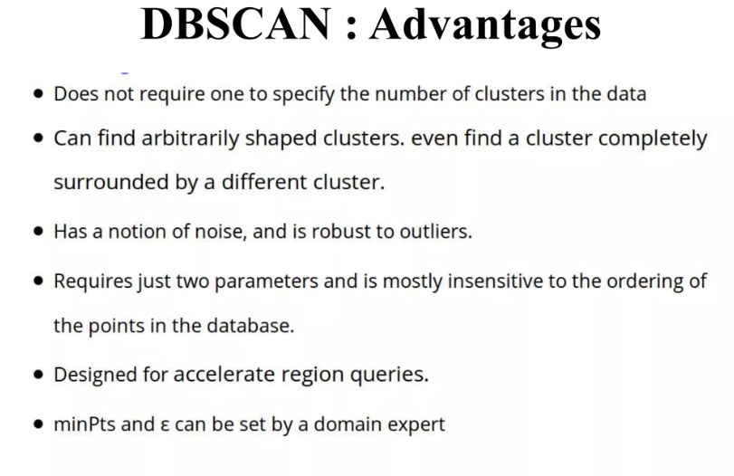

Slide 34
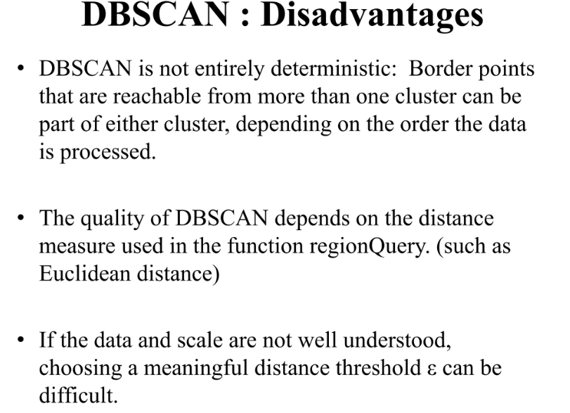

Slide 35
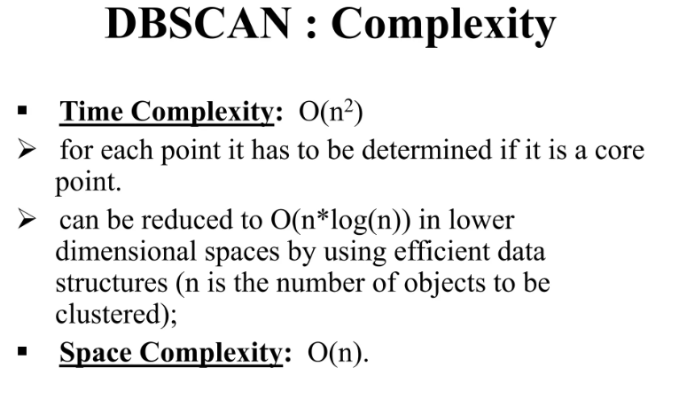

Slide 36
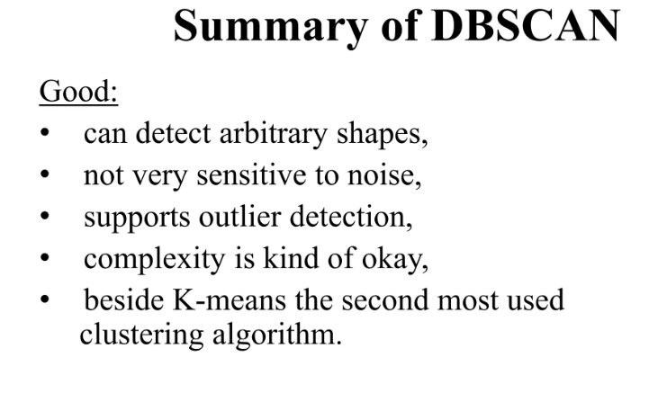

Slide 37
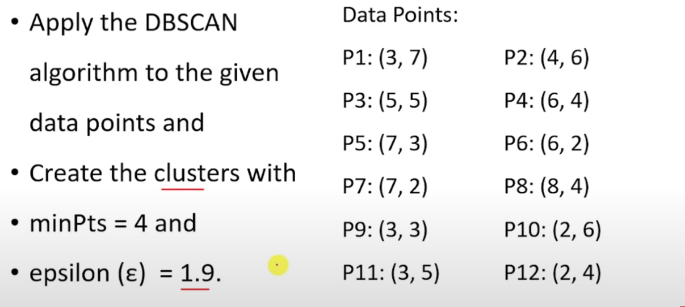
Numerical

Slide 38
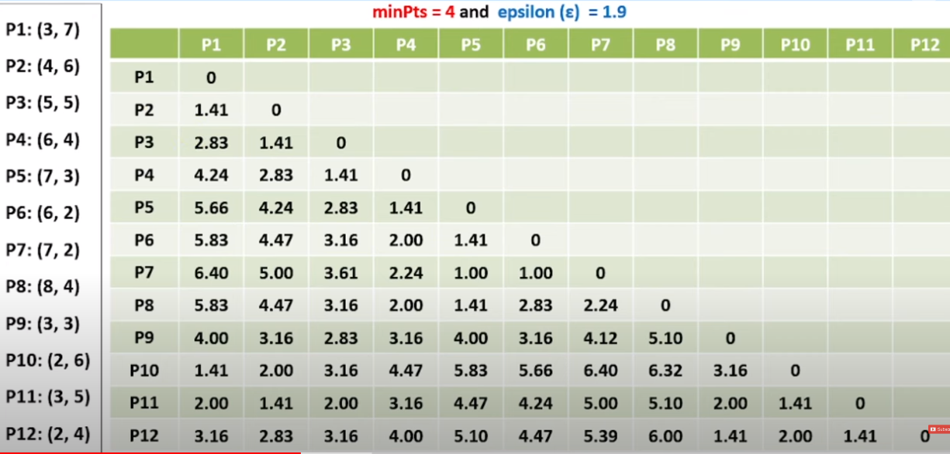

Slide 39
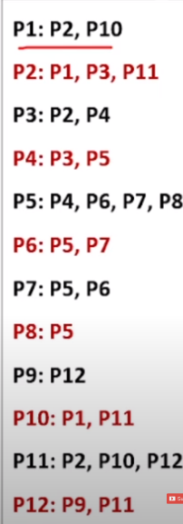

Slide 40
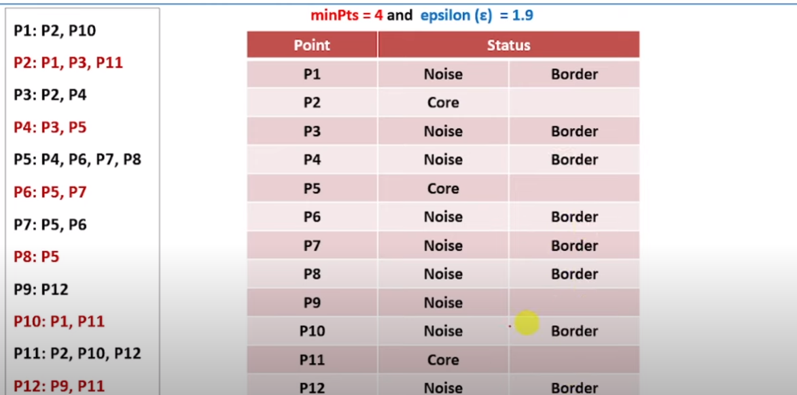

Slide 41
DBSCAN Clustering Algorithm Solved Numerical Example in Machine Learning Data Mining Mahesh Huddar - YouTube

Slide 42
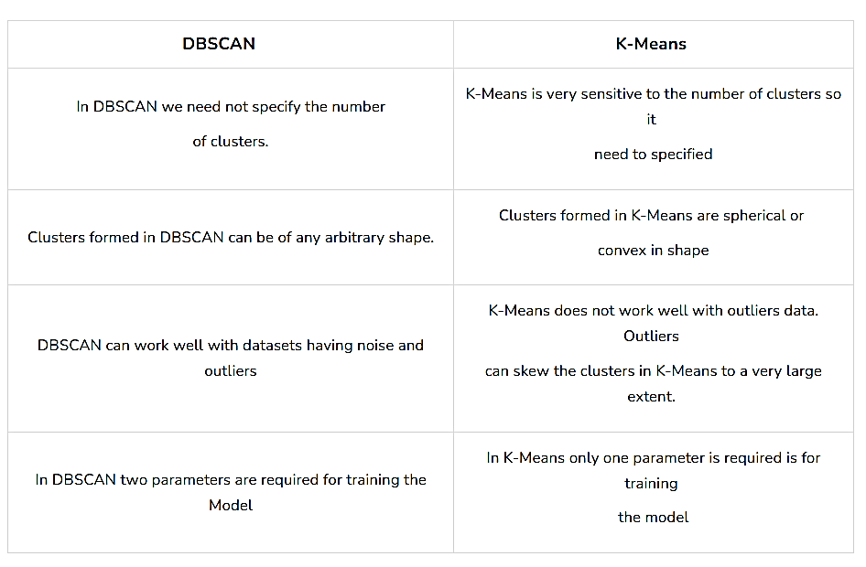

Slide 43
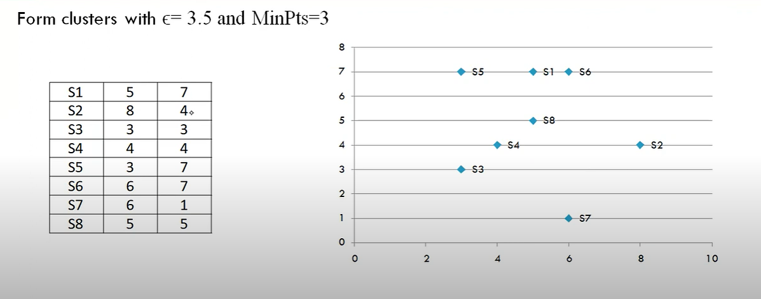
Numerical on DBSCAN

Slide 44
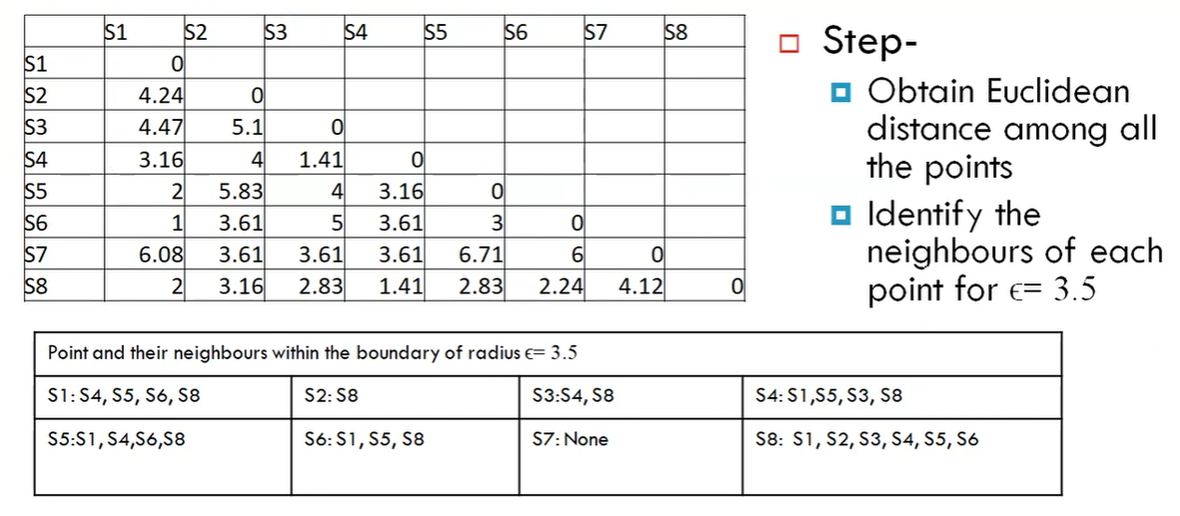

Slide 45
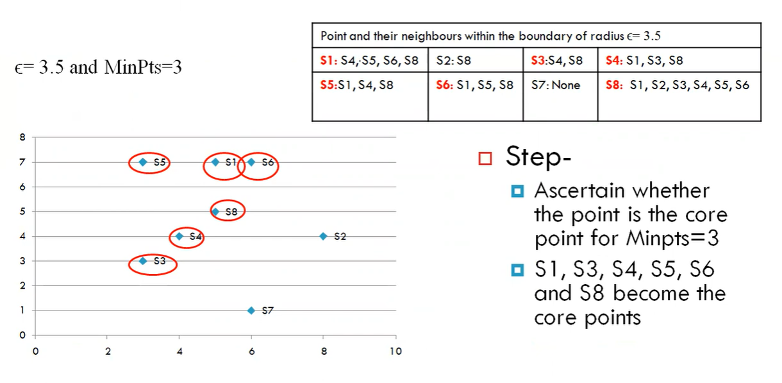

Slide 46
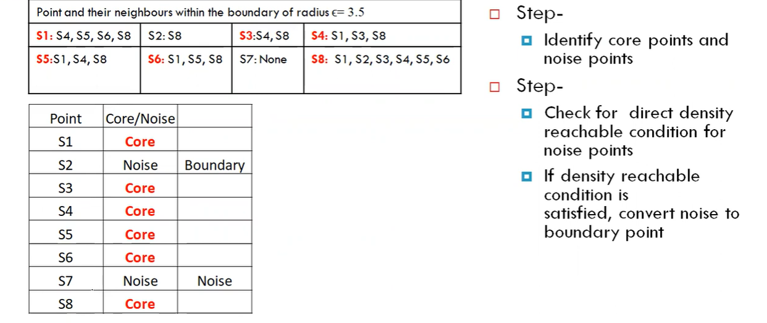
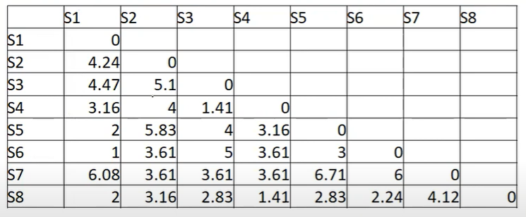

Slide 47
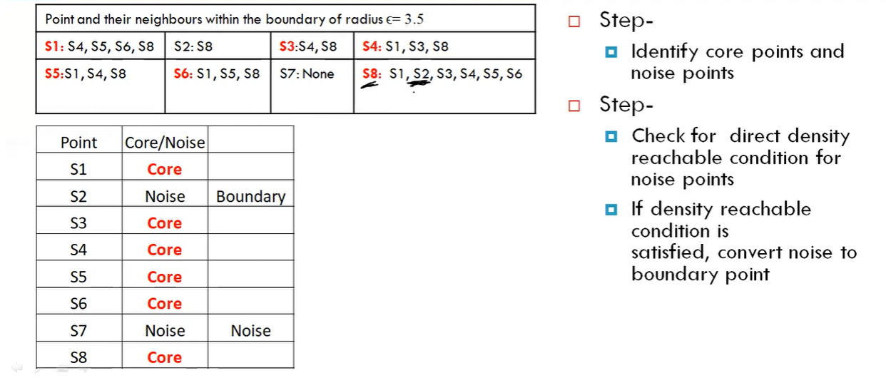

Slide 48
Some of the use cases of clustering algorithms include:
Document Clustering
Recommendation Engine
Image Segmentation
Market Segmentation
Search Result Grouping
and Anomaly Detection.

